Slide 1
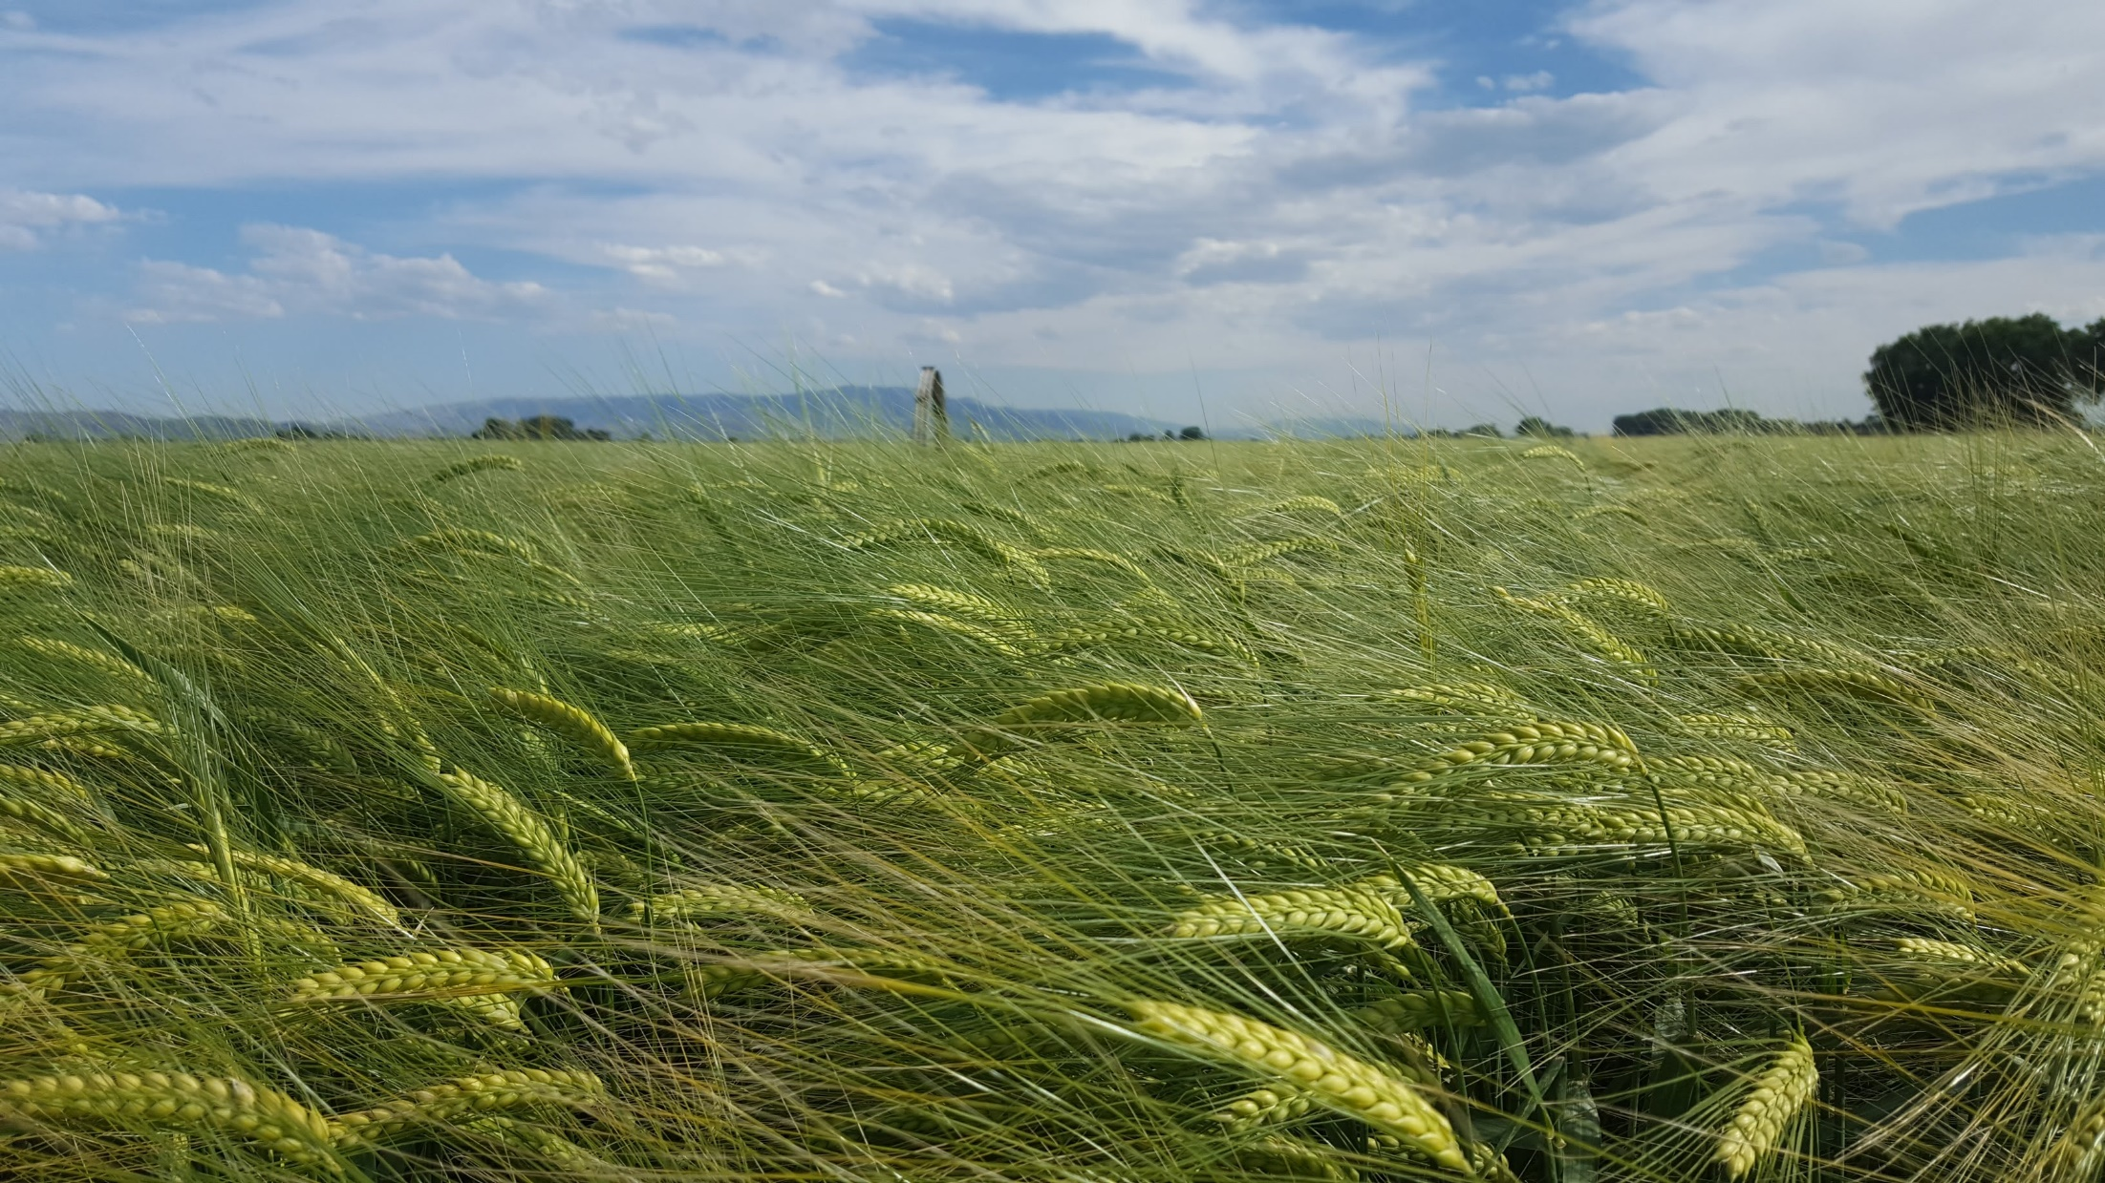
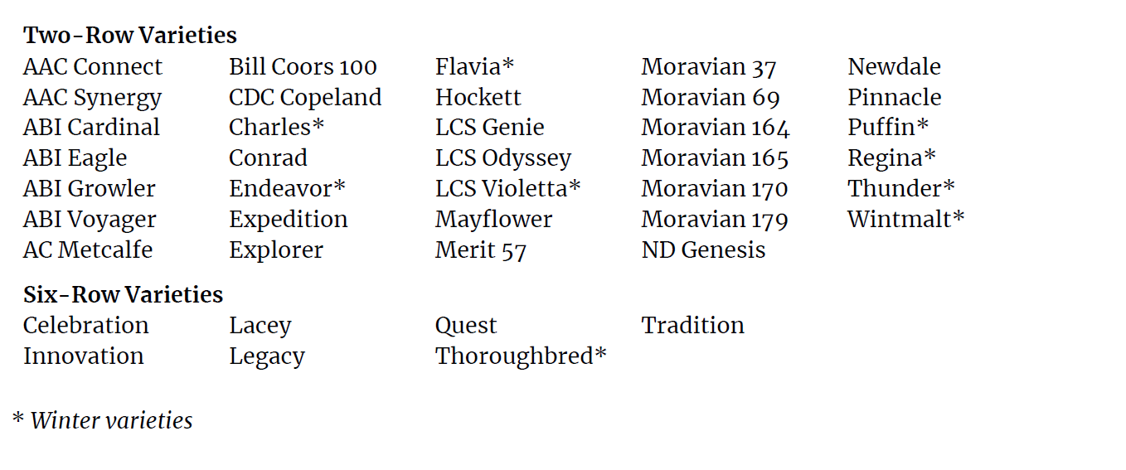
Out there
Thunder 2-row winter
Major and craft maltsters, brewers, distillers brewers
Notes:
Thunder on AMBA recommended list and likely in a beer near you. A top performer all over – but be sure to maintain a comprehensive program of fungicide protection on the wet side of the Cascades.

Slide 2
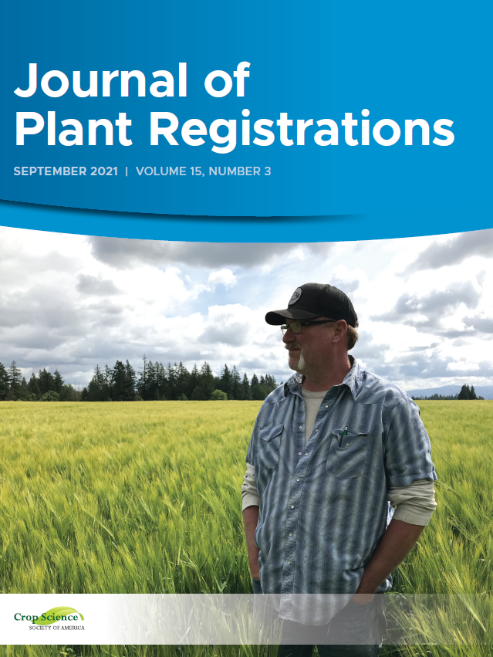
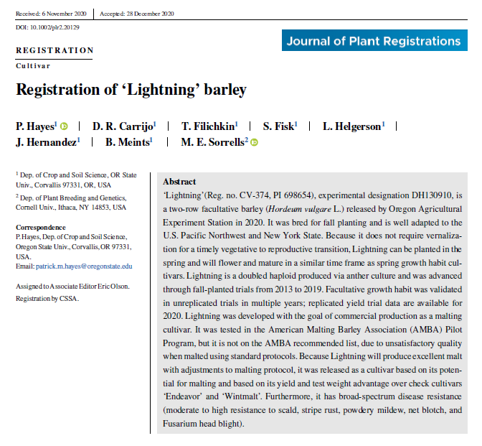
Out there
Lightning 2-row facultative
Craft maltsters and brewers
Notes:
Lightning not on AMBA recommended list – too much of a challenge to malt due to dormancy and water sensitivity. Some craft maltsters can deal with those challenges, and hence it is working for them. Facultative and excellent disease resistance – maybe even tolerance of fusarium head blight. Picture of Ed Rose, with Foundation Lightning field.

Slide 3
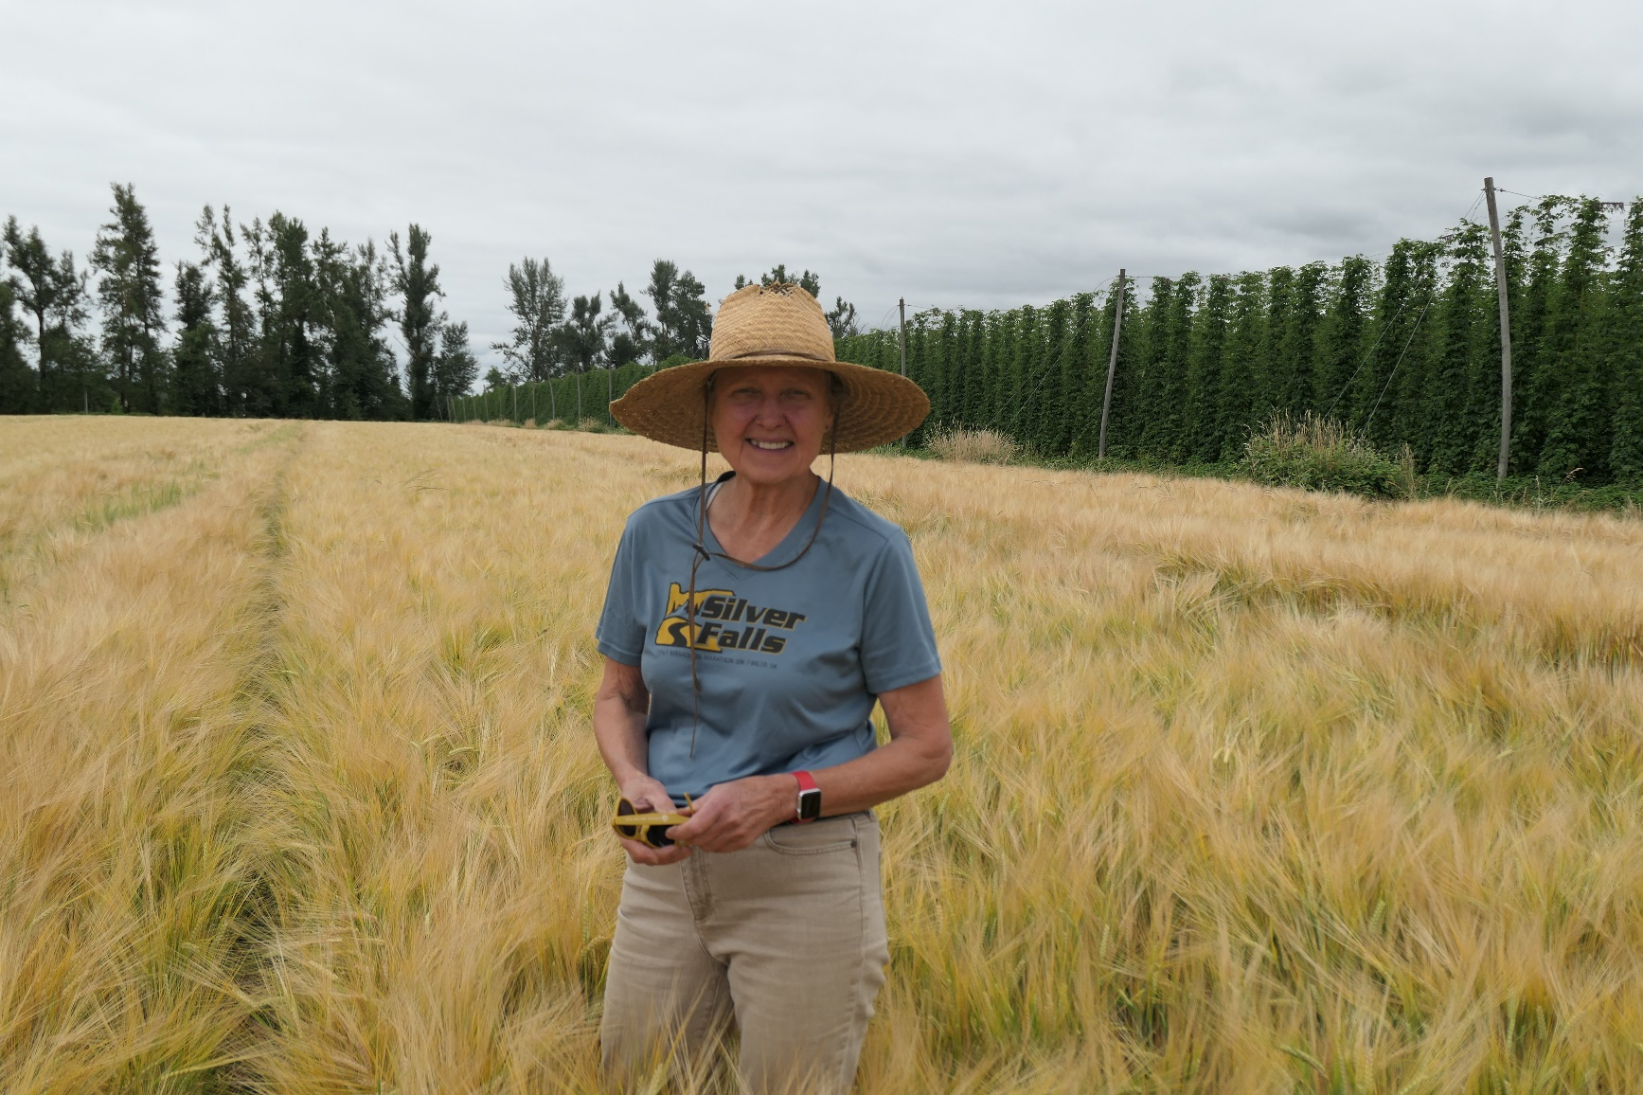
Out there
Oregon Promise 2-row spring GN0
Craft maltsters and distillers
Notes:
Top rated for beer flavor and could be the new wave in distilling – picture of Gayle Goschie from Goschie farm, 2022 harvest.
Glycosidic nitrile (GN) is the next bugbear for distillers – long story made short: who wants a cancer risk in their whisk(€)y? GN0 varieties don’t produce GN.

Slide 4
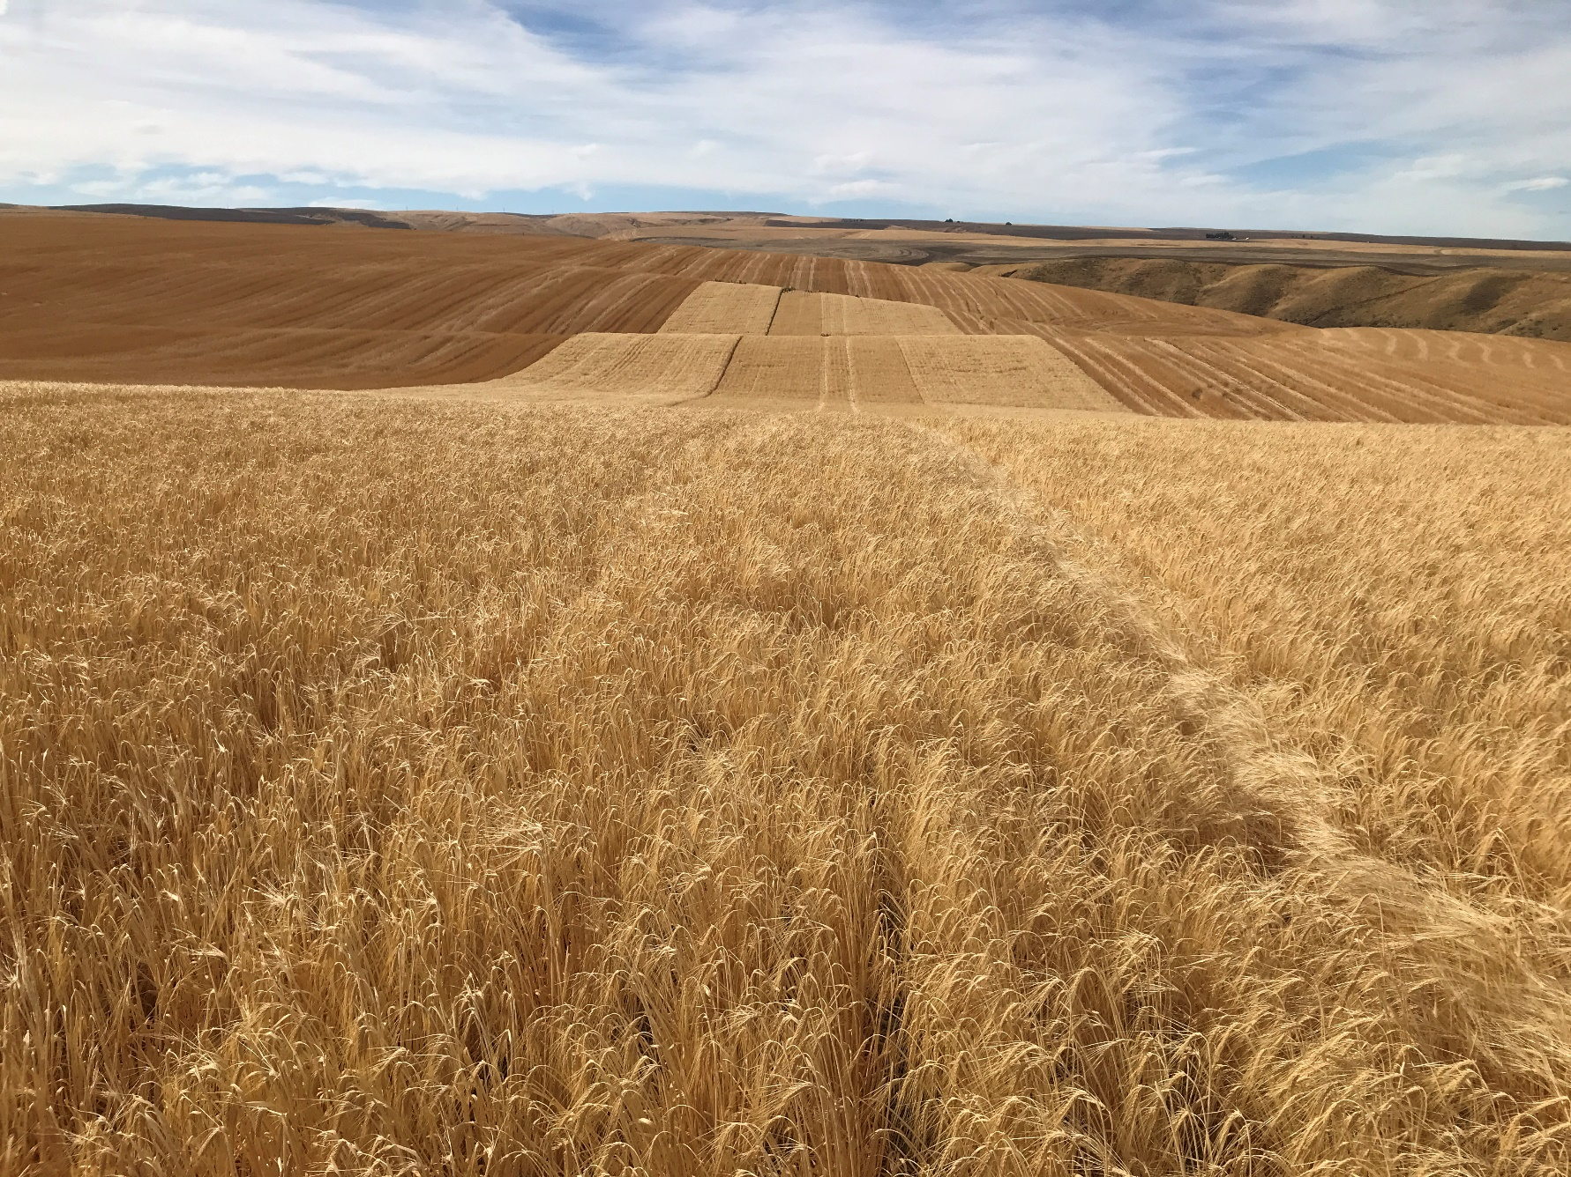
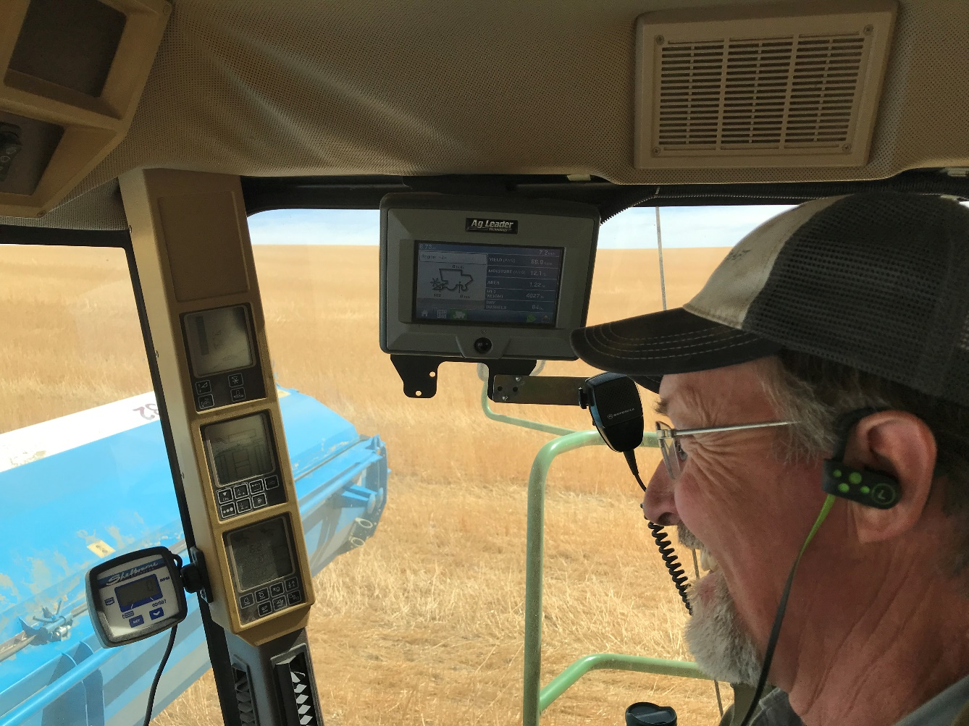
Coming in 2023
Successor* 2-row spring
Immi-tolerant feed
*Provisional
Notes:
A step Beyond WSU Survivor. That’s David Brewer smiling as the yield monitor data shows Successor > Survivor. Foundation seed available from WSCIA and for sale 2023.

Slide 5
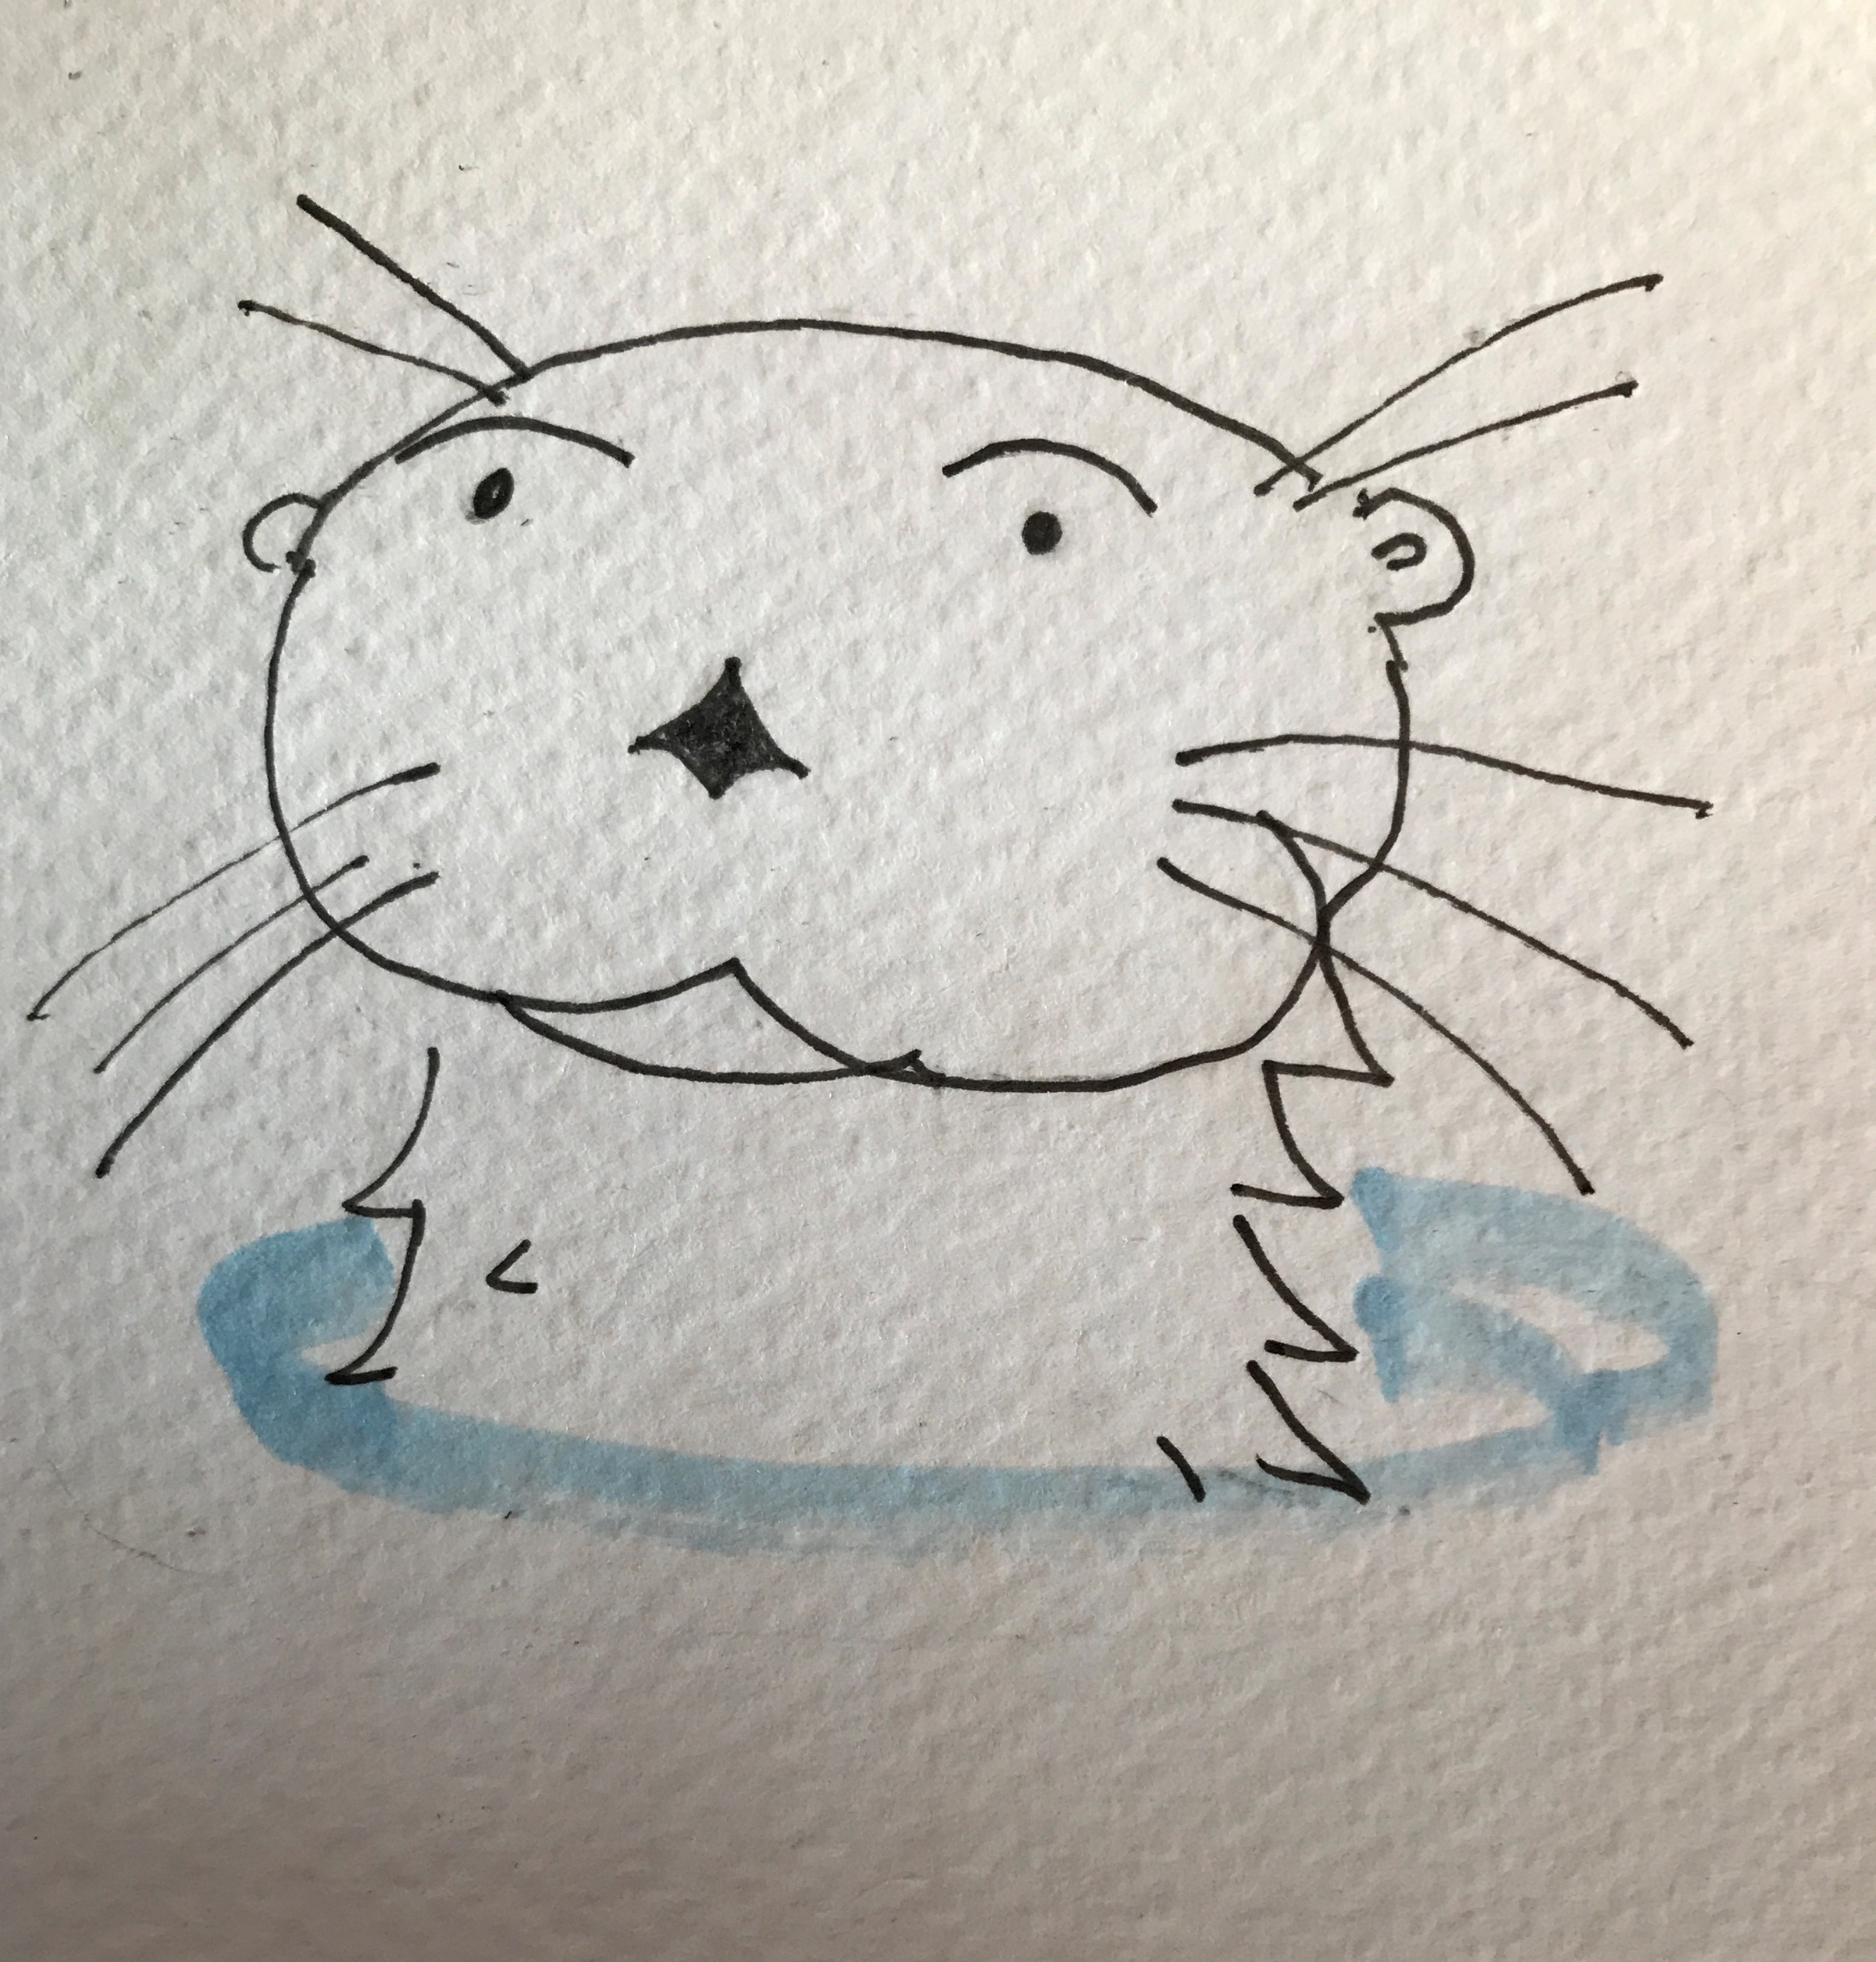
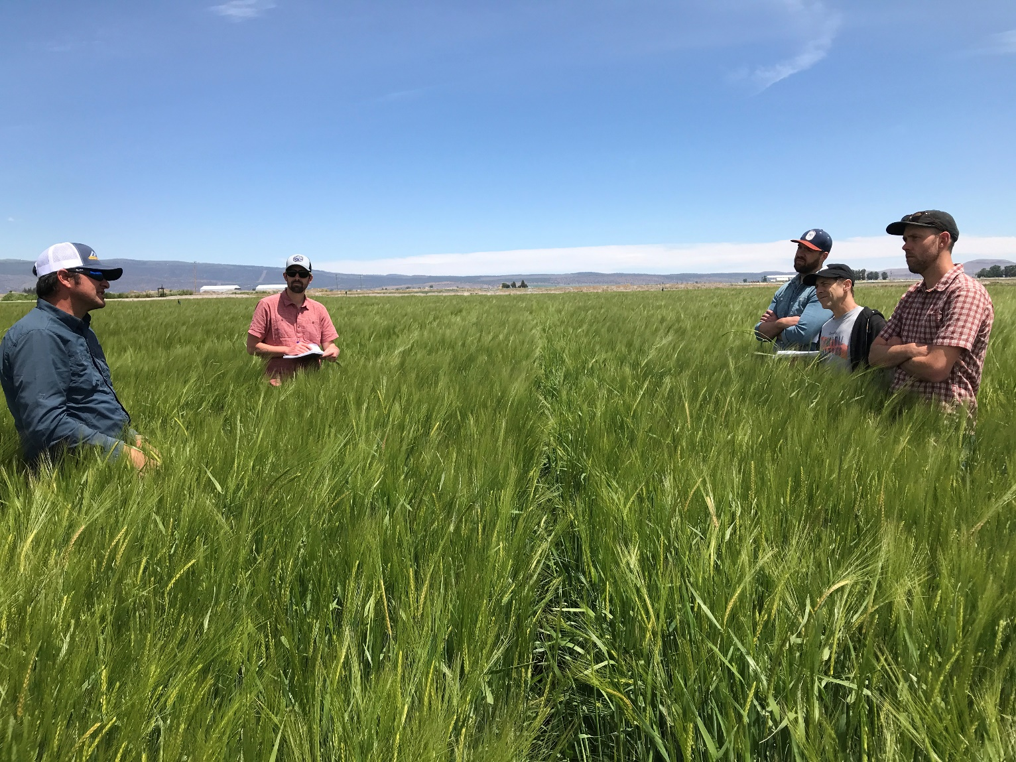
Coming in 2023
Lontra* 2-row winter malting
Craft maltsters and brewers
Lontra
Lontra Malting Barley – the New World Otter
*Provisional
Notes:
With Maris Otter in the pedigree, what’s not to like?
Foundation seed increase with WSCIA and 30 acres with MTA in Klamath Basin.

Slide 6
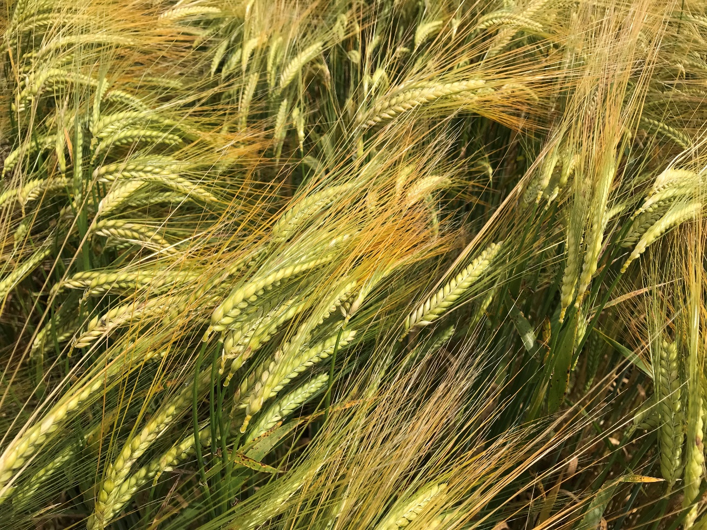
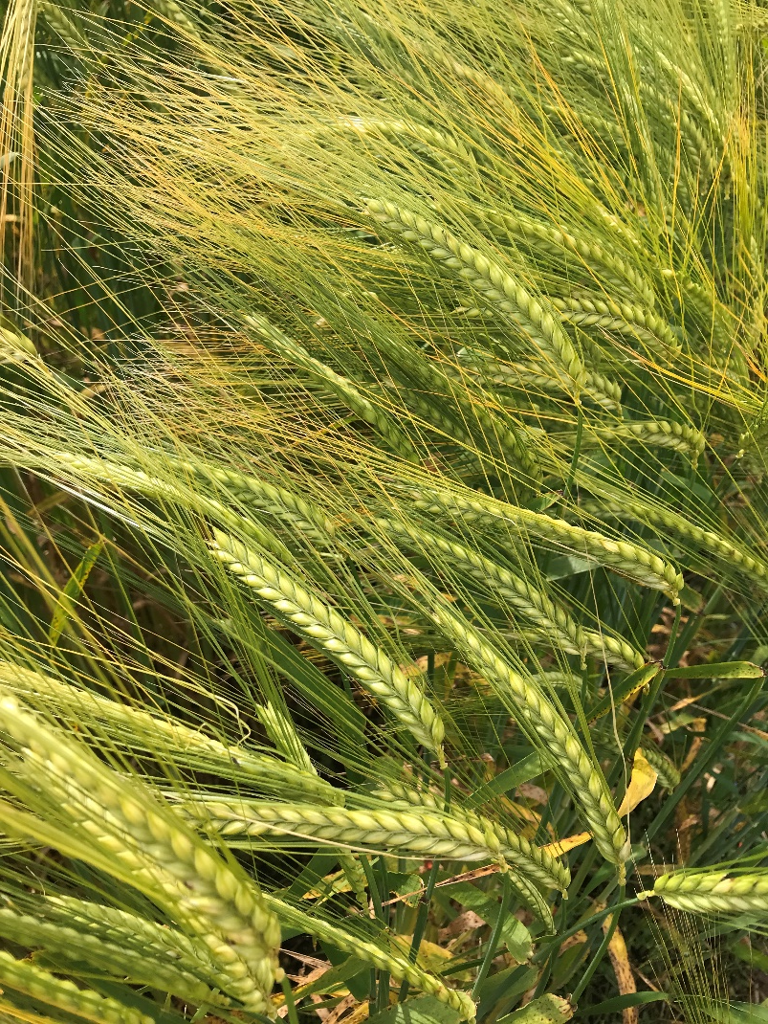
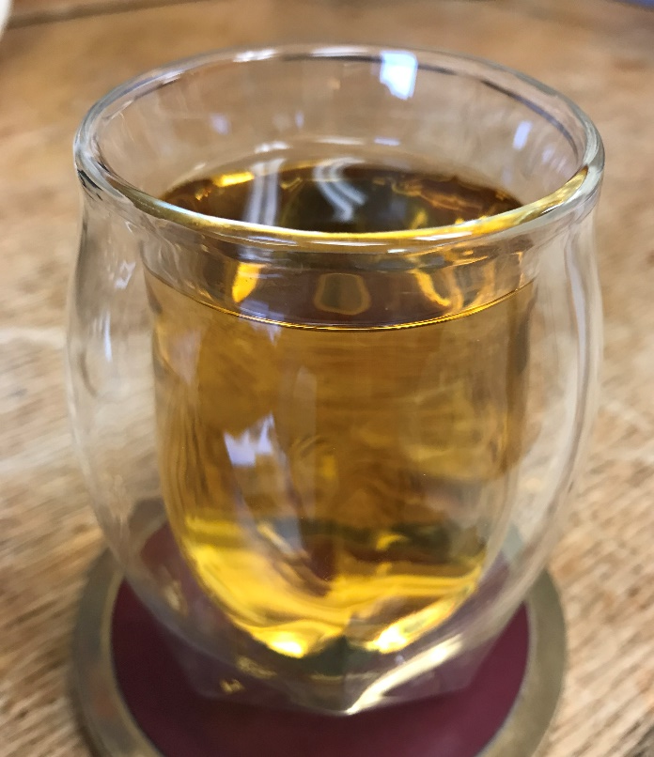
On the near horizon
DH 162310 and DH170472 2-row winter GN 0’s
Bourbon and all-malt whiskeys, respectively
Notes:
Hot properties – first North American GN0 winters.
Whiskey trials in the planning and pre-commercial test with regional maltsters.
Foundation seed increases with WSCIA and ~ 3 acre on-farm increases in Idaho and Washington with MTAs.

Slide 7
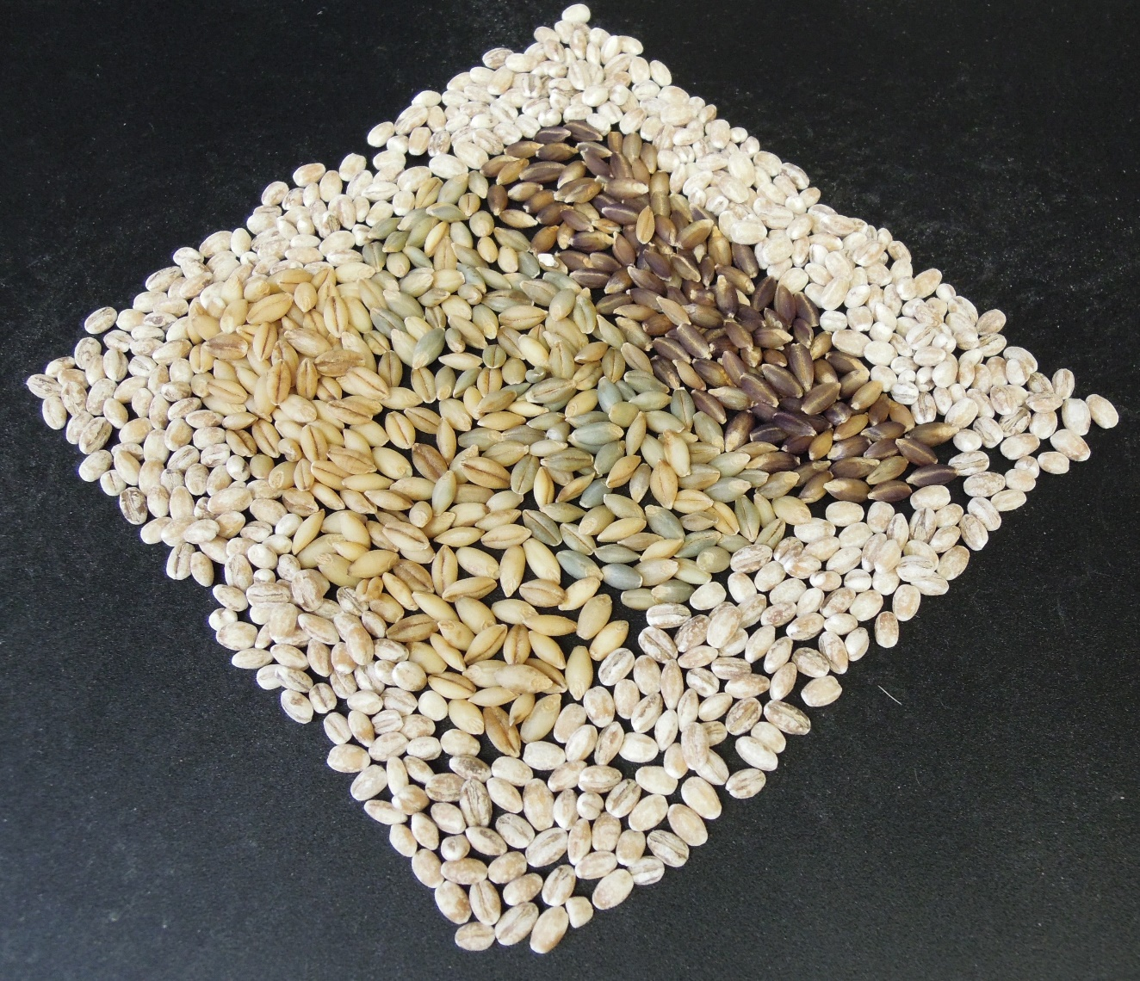
On the further horizon
A winter naked barley or two…..
Notes:
Finally, some high yielding winter 2-rows to replace Buck and Streaker.

